Slide 1
Build apps with the Microsoft Graph REST API
Build applications using Microsoft Graph REST API

Slide 2

Microsoft Graph REST API
Intro to the Microsoft Graph REST API
Getting started
SDKs & Code Samples
Resources

Slide 3
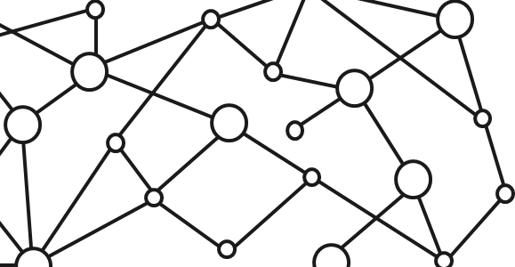
Microsoft 365 Platform
Extend Microsoft 365 experiences
web, device, and service apps
Build your experience
Documents
Pages
Conversations
Timeline
iOS/Android/Windows/Web
1
Microsoft Graph
Notes:
Our Office 365 developer vision focuses on the Users’ experience and their data. As a developer you can bring your applications into their user experience. With over 1.2+ billion users of Office Worldwide, this is a huge opportunity to provide a window into your applications. As well as being able to connect into their data and add intelligence to your applications. There are currently 850 million events created a month and a total of 470Pb+ of data stored in the service that can add value to for our Users’.

Slide 4
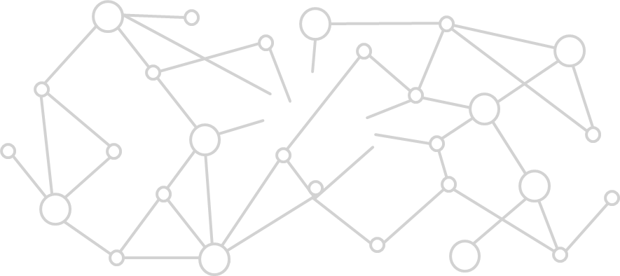
Microsoft Graph Gateway to your data in the Microsoft-cloud
https://graph.microsoft.com
Office 365
Windows 10
Enterprise Mobility + Security
Users, Groups, Organizations
Outlook
SharePoint
OneDrive
Teams
Planner
Excel
OneNote
Activities
Device Relay
Commands
Notifications
Azure AD
Intune
Identity Manager
Advanced Threat Analytics
Advanced Threat Protection
Mail, Calendar,
Contacts and Tasks
Sites and Lists
Drives and Files
Channels, Messages
Tasks and Plans
Spreadsheets
Notes, and more…
Identity Management
Access Control
Synchronization
Domains
Administrative Units
Applications and Devices
Advanced Threat Analytics
Advanced Threat Protection
Alerts
Policies
and more…

Slide 5
Microsoft Graph, gateway to Office 365
Single resource that proxies multiple Microsoft services
Allows for easy traversal of objects and relationships
Simplifies token acquisition and management
Eliminates the need to traditional discovery (using “me” and “myorganization”)

Slide 6
Office 365 direct API Endpoints
Direct API endpoints for all the Office 365 Services may also be invoked
Outlook, OneDrive, OneNote, etc.
Direct endpoints have new functionality before it is exposed via the Graph API
Examples:
Outlook web hooks
Time zone on calendar

Slide 7
Accessing the Microsoft Graph
Direct REST API
Any platform
Any language
Any framework
Native SDKs
Utilize framework & platform specific implementations
Abstracts the details of constructing & processing REST requests over HTTP
.NET, iOS, Android, PhP, Ruby, JavaScript, etc.

Slide 8
Microsoft Graph REST API

Slide 9
/me
USER
ME
userPhoto
thumbnailPhoto
responsibilities
department
pastProjects
aboutMe
hireDate
birthday
address
mobile
jobTitle
schools
name
skills
tags
alias

Slide 10
Code
GET https://graph.microsoft.com/v1.0/users/yina@contoso.com
GET https://graph.microsoft.com/v1.0/me
GET https://graph.microsoft.com/v1.0/contoso.com
/users/<id>
GET https://graph.microsoft.com/v1.0/contoso.com
/users/yina@contoso.com?$select=aboutMe
GET https://graph.microsoft.com/v1.0/me/photo

Slide 11
/users
manager
USER
directReports
memberOf
GROUPS

Slide 12
Code
GET https://graph.microsoft.com/v1.0/me/manager
GET https://graph.microsoft.com/v1.0/contoso.com
/users/yina@contoso.com/directReports
GET https://graph.microsoft.com/v1.0/me/memberOf
GET https://graph.microsoft.com/v1.0/users/<id>
GET https://graph.microsoft.com/v1.0/contoso.com/users/<id>/photo

Slide 13

/messages
manager
USER
directReports
memberOf
GROUPS
MESSAGES

Slide 14
Code
GET https://graph.microsoft.com/v1.0/me/messages
GET https://graph.microsoft.com/v1.0/me/messages?$top=5
GET https://graph.microsoft.com/v1.0/me
/messages?$top=5&$skip=5&$orderby=DateTimeCreated
GET https://graph.microsoft.com/v1.0/me
/messages?$top=5&$select=Subject,Sender&
$search="from:alexd@contoso.com"

Slide 15

/events
manager
USER
directReports
EVENTS
memberOf
GROUPS
MESSAGES
MESSAGES

Slide 16
Code
GET https://graph.microsoft.com/v1.0/me/events
GET https://graph.microsoft.com/v1.0/me/events?$top=5
GET https://graph.microsoft.com/v1.0/me
/calendarview?startdatetime=2015-04-01t01:00:00z
&enddatetime=2015-04-16t23:00:00z

Slide 17


/drive
Shared with me
createdBy
public
manager
USER
directReports
directReports
EVENTS
EVENTS
modifiedBy
FILES
memberOf
GROUPS
MESSAGES

Slide 18
Code
GET https://graph.microsoft.com/v1.0/me/drive/root/children
GET https://graph.microsoft.com/v1.0/me/drive/items/<id>
GET https://graph.microsoft.com/v1.0/me
/drive/items/<id>/lastModifiedByUser
GET https://graph.microsoft.com/v1.0/mary@contoso.com/drive
/root/children
GET https://graph.microsoft.com/v1.0/mary@contoso.com
/drive/items/<id>/lastModifiedByUser/manager

Slide 19

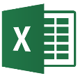
/tasks
trendingAround
trendingAround
Shared with me
createdBy
CONVERSATIONS
public
manager
USER
workingWith
directReports
directReports
directReports
directReports
EVENTS
EVENTS
trendingAround
trendingAround
modifiedBy
TASKS
FILES
memberOf
memberOf
memberOf
workingWith
TASKS
GROUPS
GROUPS
GROUPS
createdBy
MESSAGES
FILES

Slide 20
Code
GET https://graph.microsoft.com/v1.0/me/planner/tasks
GET https://graph.microsoft.com/v1.0/contoso.com
/users/yina@contoso.com/planner/tasks
GET https://graph.microsoft.com/v1.0/contoso.com
/groups/<id>/planner/plans/<id>/tasks

Slide 21
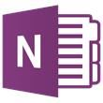
API
trendingAround
Shared with me
createdBy
CONVERSATIONS
public
manager
USER
workingWith
directReports
EVENTS
trendingAround
modifiedBy
TASKS
FILES
memberOf
workingWith
TASKS
GROUPS
createdBy
NOTES
NOTES
MESSAGES
FILES

Slide 22
Azure AD Applications: The Microsoft Graph Dependency
All Microsoft Graph access options (REST API / SDKs) depend on Azure AD
Must register an Azure AD application to access the Microsoft Graph
Use the Azure AD application to authenticate, gain authorization & obtain an access token
Access token included in the underlying HTTP request to call the Microsoft Graph endpoint

Slide 23
Single authentication flow for Office 365
Sign users in using OpenID Connect
Azure AD and Office 365 services
Supports MFA and federated user sign-in
Device apps, web sites, SPAs, and service apps
Pin apps to Office 365 app launcher from My apps

Slide 24
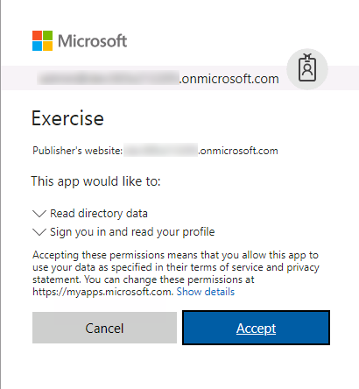
Common consent
Single auth flow for accessing all O365 services
Admin and end-user consent
Secure protocol
OpenID Connect and OAuth 2.0
No capturing user credentials
Fine-grained access scopes
Long-term access through refresh tokens

Slide 25
Authentication Options
Azure AD only
Separate auth flow supports Azure AD accounts only
Azure AD and Microsoft Accounts
Converged auth flow supports Azure AD accounts and Microsoft accounts (LiveID - hotmail.com, etc.)

Slide 26
Microsoft Account + Azure AD
Many apps want to sign users in from both Microsoft account and Azure AD
Single endpoint, OpenID Connect and OAuth 2.0
Single SDK
Single end user sign in experience
Single app registration experience
Works with Microsoft Graph
Single API endpoint, business and consumer data

Slide 27
Registering an Azure AD application for interacting with the Microsoft Graph

Slide 28
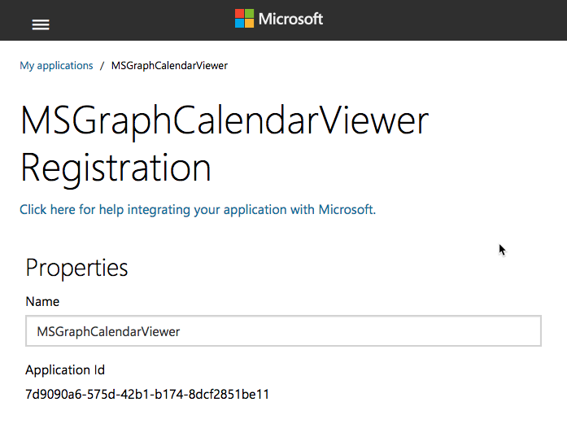
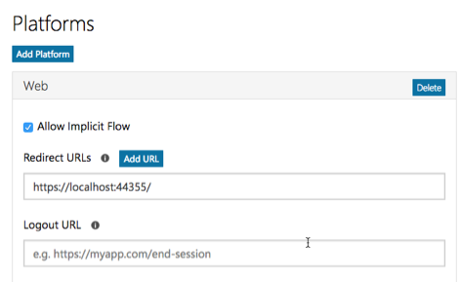
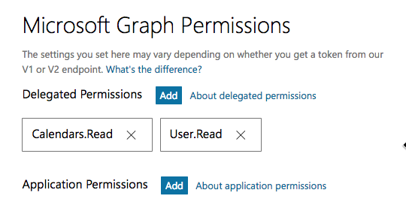
Application registration
Create a new application
Create a new application in the Application Registration Portal. A unique identifier is created for your app.
Add a Web platform
Add a web platform to your application registration.
Optionally add permissions
Add permissions that your application will need if your admin will consent for all users. Or leverage dynamic consent for requesting permissions.

Slide 29
Demo

Slide 30
Thank you.

